Slide 1
Learn SQL from Scratch
Capstone : Usage Funnels with Warby Parker
Capstone by: Kevin Howell

Slide 2
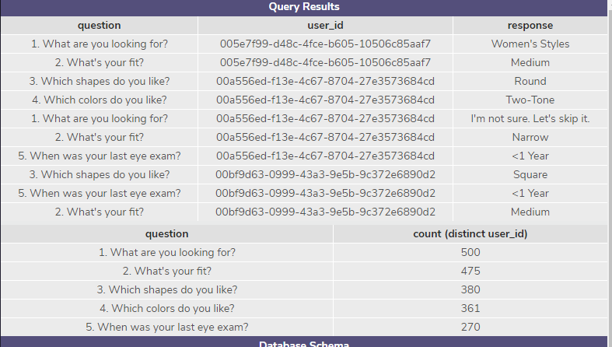
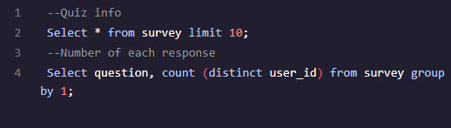
Learning the Style Quiz
The first steps where to look at the types of questions on the quiz and find the number of responses to each answer.

Slide 3

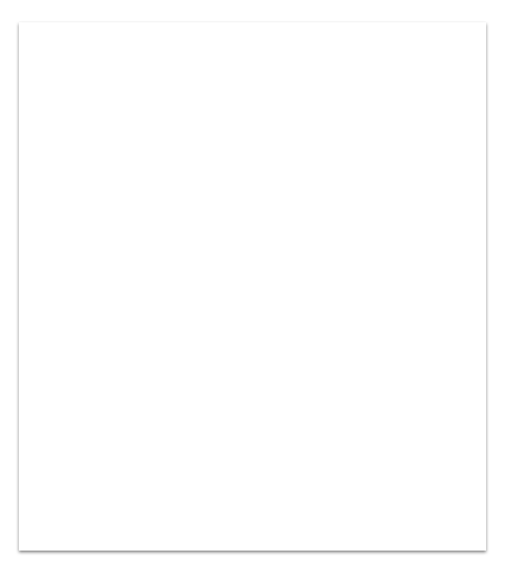
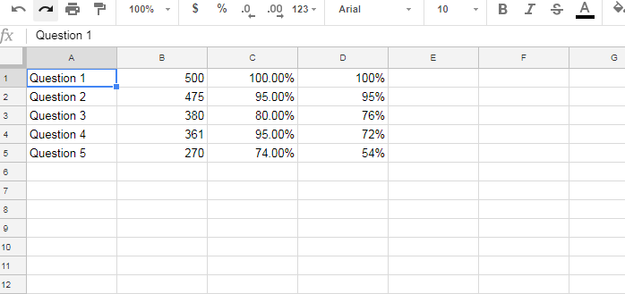
From the numbers on the previous slide we are able to calculate the percentages of completion from question to question ‘C’ and overall ‘D’.
This means that question 3 and 5 have the lowest percent completion. Probably due to the questions. Three is an odd question asking shapes you like and 5 is a relatively personal question with asking when was you last eye exam. These questions are less likely to be answered.
Style Question completion by percentage

Slide 4
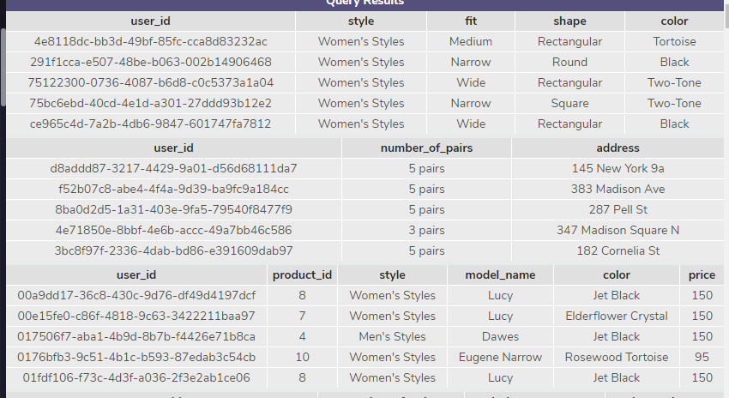
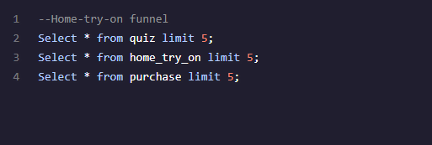
Getting to Know the graphs
The following code lets me get an overview of the three tables I am working with. So I can see the the names of the columns in in each table. This includes Quiz: User_id, Style, Fit, Shape, Color.
Home_try_on: User_id, number_of_pairs, Address. Finally, Puchase: User_id, product_id, Style, Model_name, Color, Price.
Tip
In this example, we’re leading off with something unexpected.
While the audience is trying to come up with a number, we’ll surprise them with the next slide.

Slide 5
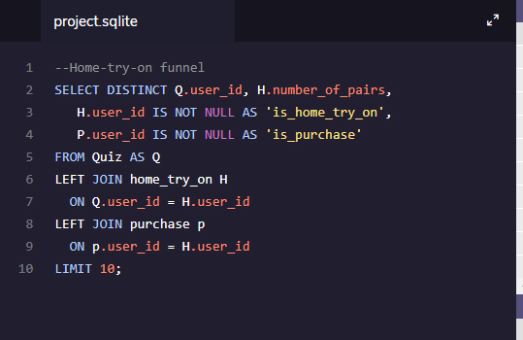
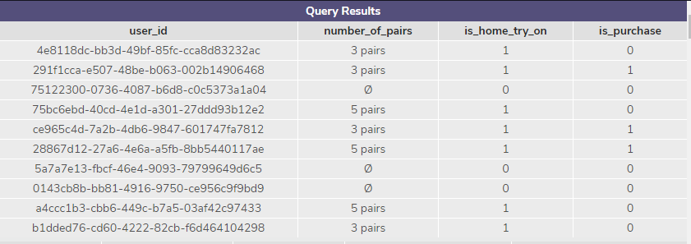
Building a Table for comparison
Using the following Code we are able to create a table showing the users who had home try ons and who purchased the product along with The in home try one. It also shows the pairs in the home try on.

Slide 6
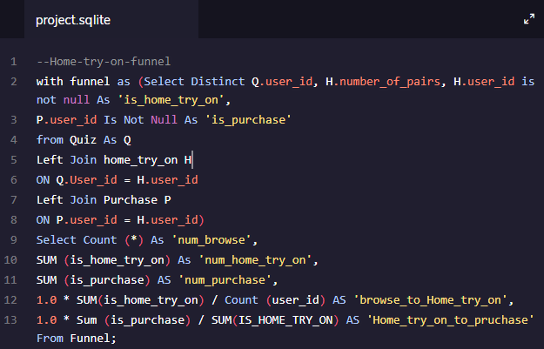
Comparison Table continued
From building upon the previous code we are able to find the conversions from each step in the process by percentage. This shows that there is a 75% conversion from browsing to home try on and a 66 % conversion from home try on to purchase.

Slide 7

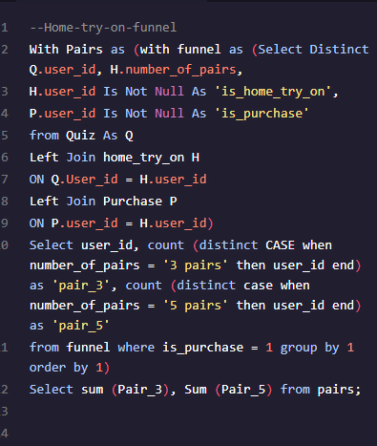
The better home try on
Building off the previous code were are able to look at the Home try on experience and if 3 pair or 5 pair model works better. As the graph shows there is a significant increase in the numbers being sold when 5 pair in home try on are being implemented so the the company may want to move in that direction to increase the end sales.

Slide 8
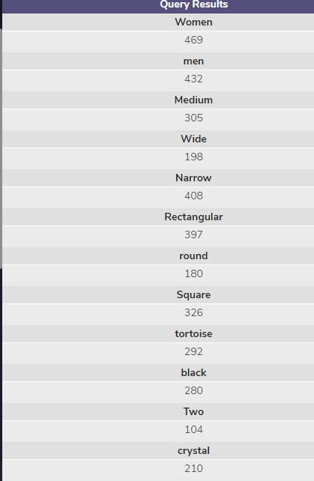
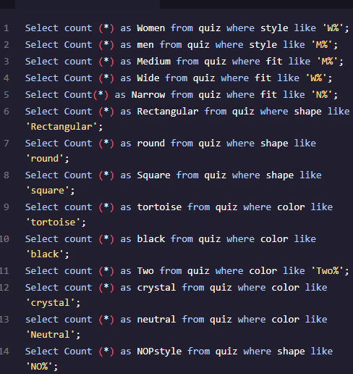
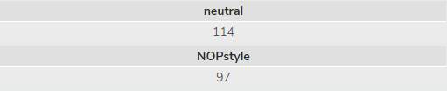
What the people want.
I started this off doing it the long way but the codes show how many people answered what on parts of the survey using this knowledge we can see that woman are buying more with narrow, rectangular, or square frames and preferring tortoise or black in color. This data can be used to market the product to the audiences and displaying more of what the people want.
Tip
Tell the audience about the problem through a story, ideally a person.

Slide 9
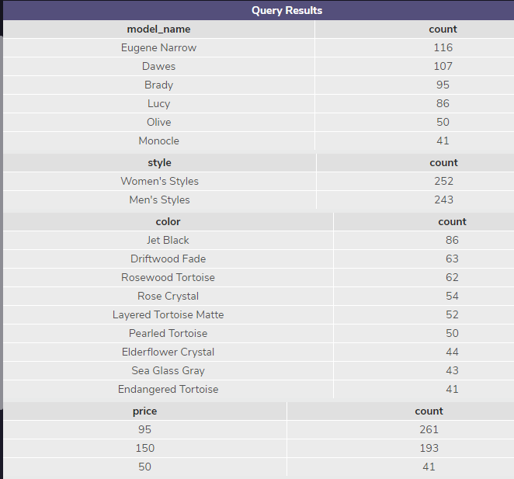
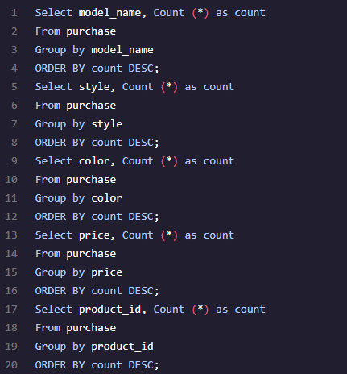
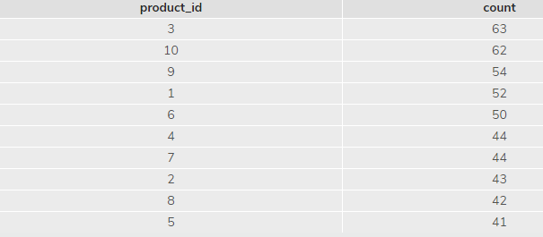
This is the short way to see it but it shows the most purchased items by the Columns allowing the buissness to see what is selling and improve.
What people are buying
H
Looks like Eugene Narrow, women’s, Jet Black, and 95 dollars are the highest sellers.

Slide 10

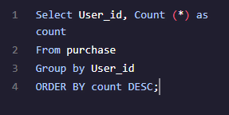
Recurring orders
The last thing I wanted to look at was if people purchased multiple time or just once. Using the code I looked for anyone with more than one but all users where only once and so the assumption is this is a new table so the customers who bought along time ago are not included or that users are not repeating customers. This could be viewed as a sales problem. Although it would haft to be viewed in context.

Slide 11
Closing
From the DATA we summarized the company will be able to improve its quizzes by adjusting question five and also push sales towards what is wanted and what is purchased. It can also begin to view ways to create opportunities for recurring customers. With using our data the company is sure to succeed
Code link Github: https://gist.github.com/871b66422f07bf701808dbc8119a0ddf
Thank you: By: Kevin Howell

